Slide 1
Failure of Graphics Card
Preventing Issues and Recovery Strategies

Slide 2
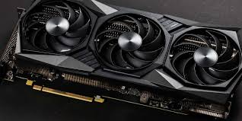
Introduction
Graphics cards (GPUs) are critical components in modern computers, used for rendering images, videos, and animations. Understanding the common signs of GPU failure, the underlying causes, and effective strategies for prevention and recovery is essential for maintaining optimal system performance. This presentation will provide insights into identifying GPU-related issues and the necessary steps to address them.

Slide 3
1
Understanding GPU Failure
Driver crashes or screen freezing
Overheating or loud fan noise
System not booting / black screen
Poor game performance

Slide 4
Common Signs of GPU Failure
Graphics card failure can manifest in various ways, including distorted images, screen flickering, and sudden crashes during intensive tasks. Users may experience unexpected lines or artifacts on the display, overheating issues, or the inability to run graphics-intensive applications. Recognizing these signs early is crucial for preventing further damage and ensuring system stability.

Slide 5
Causes of GPU Failure
Several factors contribute to GPU failure. Overheating due to inadequate cooling, dust accumulation, or aging components can lead to performance degradation. Power surges and faulty connections can also damage the graphics card. User negligence, such as improper installation or overclocking without proper thermal management, may accelerate failure.

Slide 6
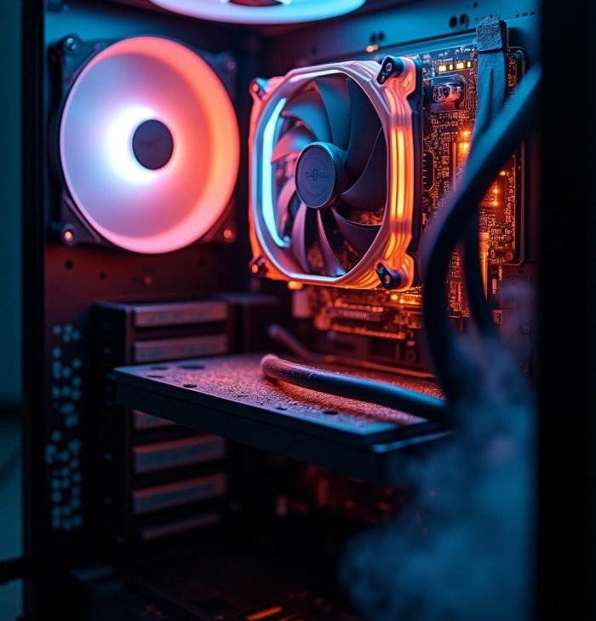
Impact on System Performance
A failing GPU can significantly hinder overall system performance, leading to sluggish responses and reduced graphical fidelity. Users may encounter lower frame rates in gaming applications, increased loading times, and even system freezes during high-demand tasks. In severe cases, extended GPU issues can result in complete system failures, necessitating hardware replacements, which incurs additional costs and downtime.

Slide 7

Preventing GPU Failure
To prevent GPU failures, ensuring proper ventilation and cooling systems is vital. Regularly cleaning dust from the GPU and ensuring that the cooling fans are functioning efficiently can prevent overheating. Additionally, users should avoid excessive overclocking without adequate cooling solutions and utilize high-quality power supplies to minimize the risk of power surges that could damage the graphics card.

Slide 8
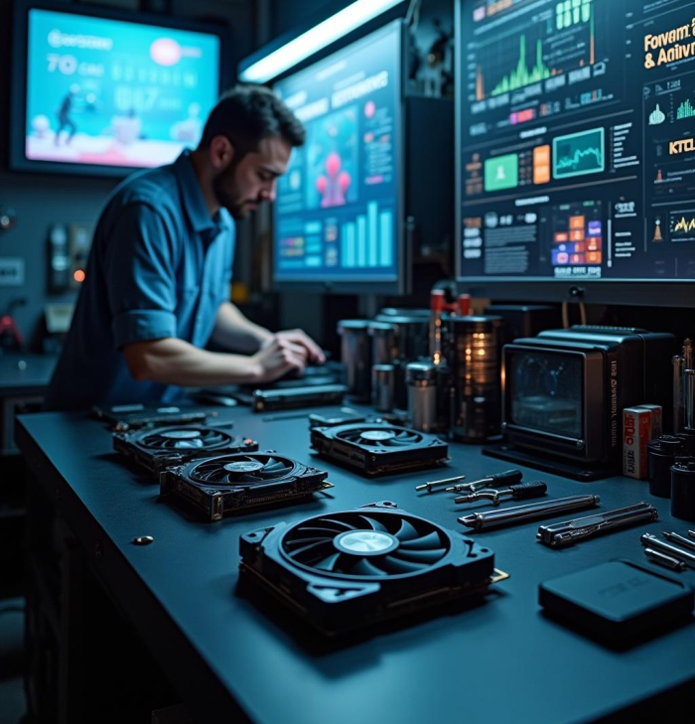
Recovery Steps After Failure
In the event of GPU failure, the first step is to troubleshoot the issue by checking for loose connections and ensuring that drivers are updated. If the GPU shows signs of physical damage, it may need to be replaced. For recoverable situations, reinstalling drivers or restoring to previous system configurations might resolve the problem. In extreme cases, seeking professional repair services may be necessary to recover damaged components.

Slide 9
Future Considerations for Hardware Maintenance
As technology evolves, maintaining hardware becomes increasingly important. Users should regularly evaluate their systems, considering upgrades when they no longer meet performance needs. Additionally, investing in better cooling solutions and monitoring the temperatures of hardware components can prolong the lifespan of the GPU. Staying informed about industry trends will also assist in making better decisions regarding hardware investments.

Slide 10
Conclusion
Understanding GPU failures is essential for maintaining a high-performing computer system. By recognizing signs of failure, implementing preventive measures, and knowing recovery options, users can effectively manage GPU-related issues. Prioritizing regular maintenance and staying informed about emerging technologies will ensure optimal performance and extend the lifespan of critical hardware components.

Slide 11

Thank you!
Do you have any questions?
+00 000 000 000

